Slide 1

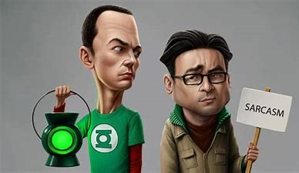
Sarcasm Detection
Submitted By:
Shaurya Negi
Reshma Madhavankutty
Rishab Mahajan
Krish Shah
Kunal Dubey

Slide 2
Contents
Introduction
Dataset Description​
Exploratory Data Analysis​
Data Pre-Processing
Machine Learning Modeling
Deep Learning Modeling
Results

Slide 3

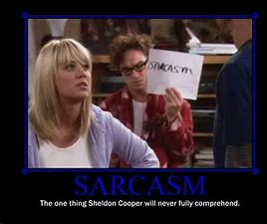
Introduction
To generate freshness in the dataset selection for Natural Language Processing which is generally centered to Tweets form Twitter website.
On exploring dataset we came across this dataset which captured our attention like moth to a flame.
Identifying Sarcasm is challenging task even for smartest individuals and we wanted to see how machines will fare in detecting sarcasm.

Slide 4
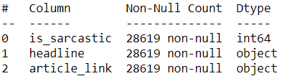
Dataset Description
The dataset includes Headlines from two news website :
The Onion aims at producing sarcastic versions of current events
Real (and non-sarcastic) news headlines from HuffPost
On basic Data Exploration, we observed:
Dataset has no duplicates
No null values in the dataset

Slide 5
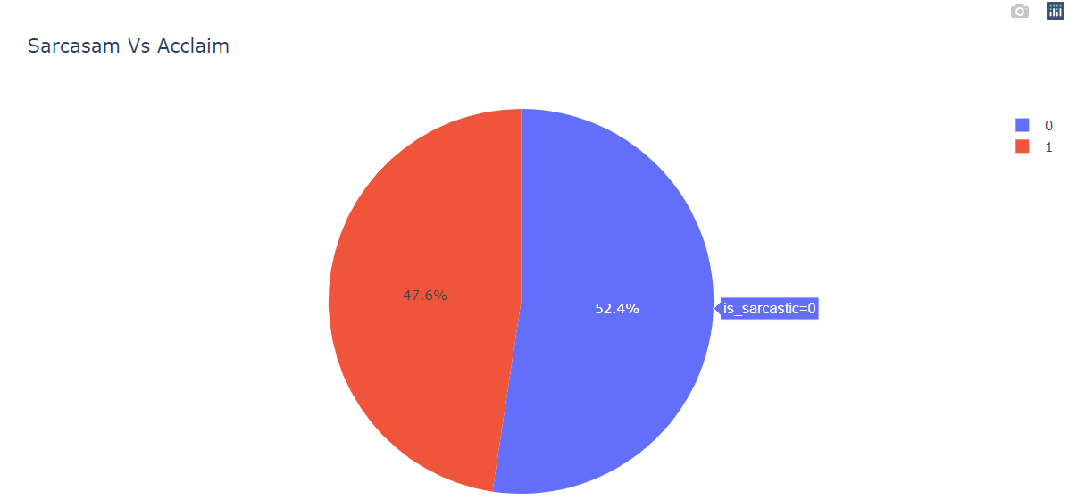
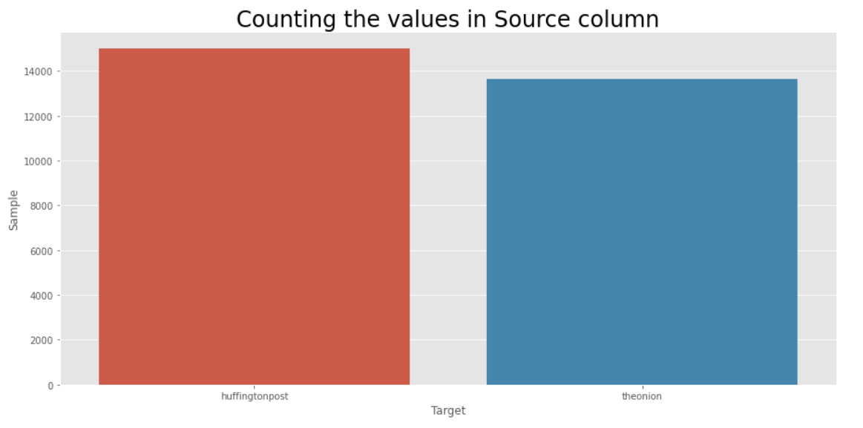
Exploratory Data Analysis
As a basic exploration, we visualize the types of words that occur frequently in each category through Bar Charts, World Clouds etc

Slide 6
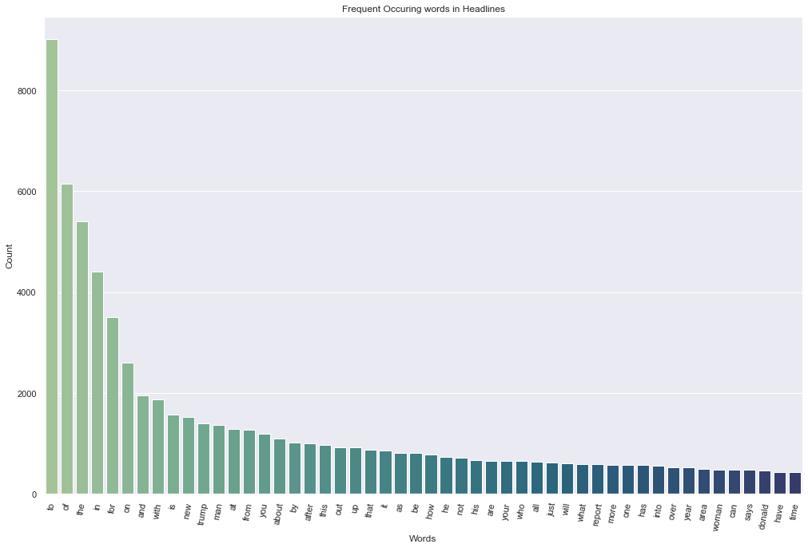
Frequency of words for whole Dataset

Slide 7
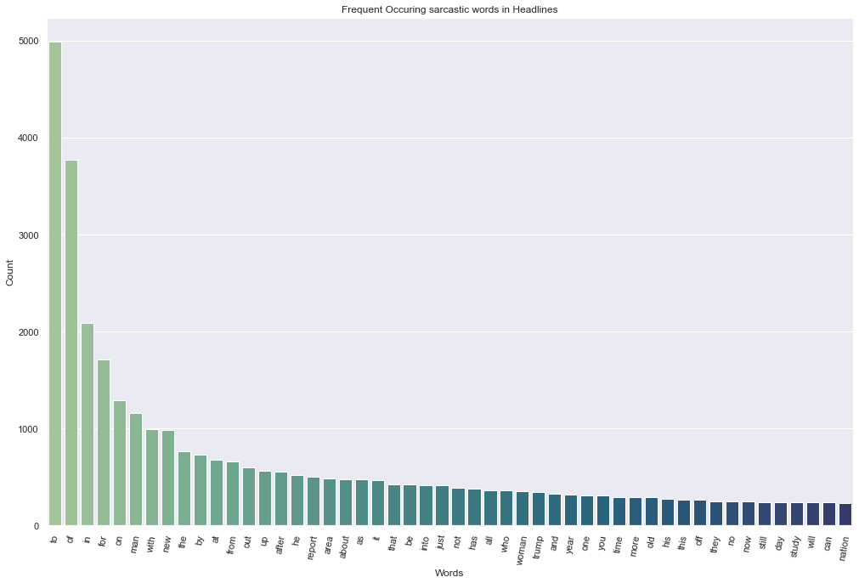
Frequency of words for Sarcastic Headlines

Slide 8
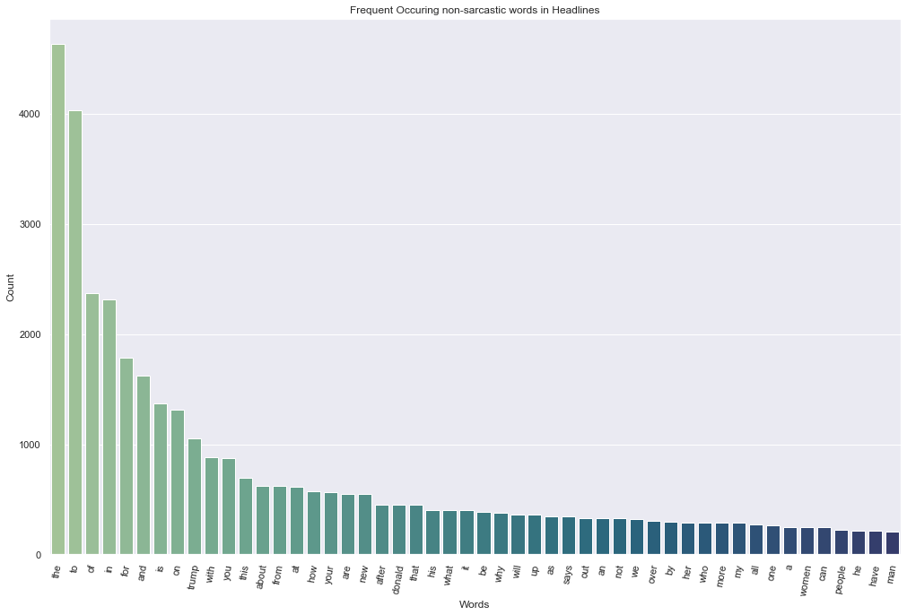
Frequency of words for Non-Sarcastic Headlines

Slide 9
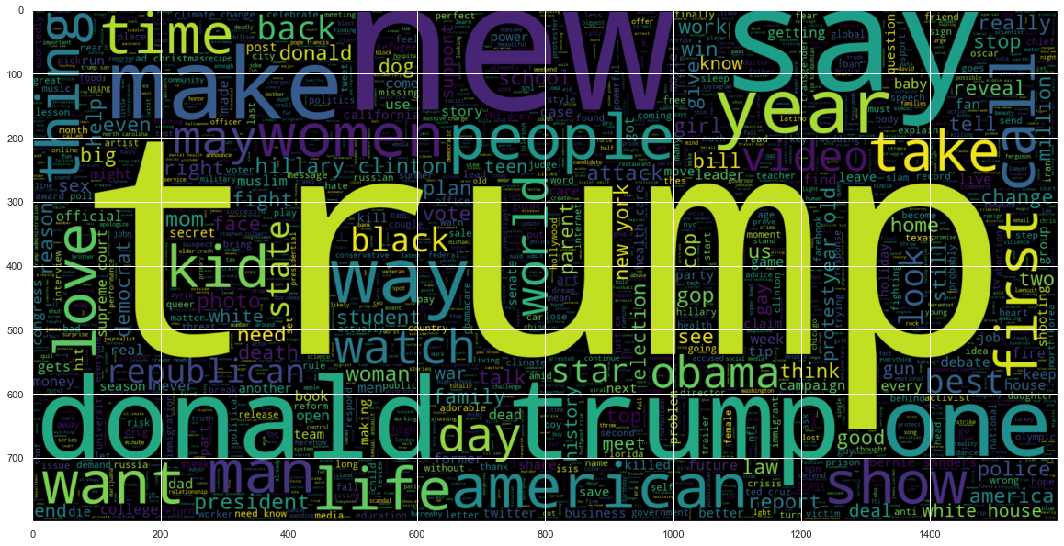
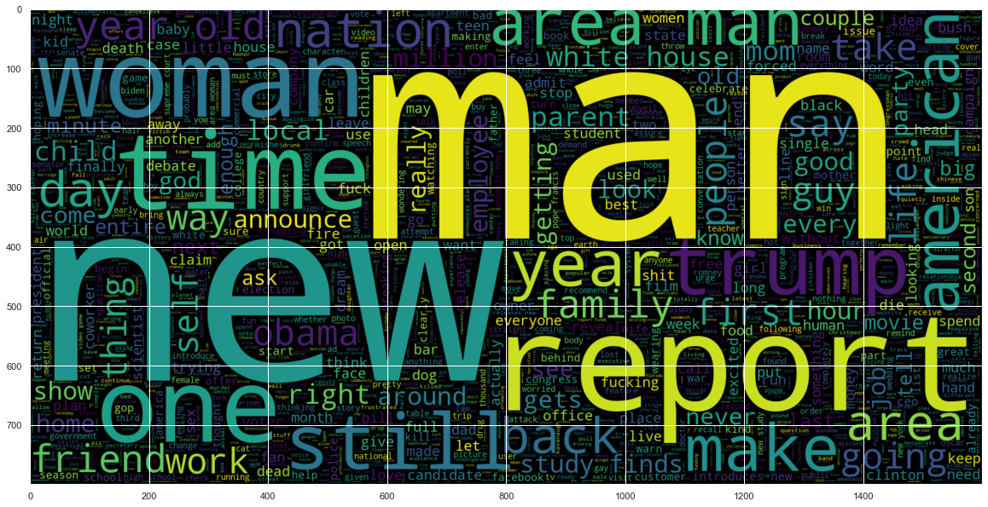
Word Cloud
World Cloud for Non-Sarcastic Headlines
Frequency of words for Sarcastic Headlines

Slide 10
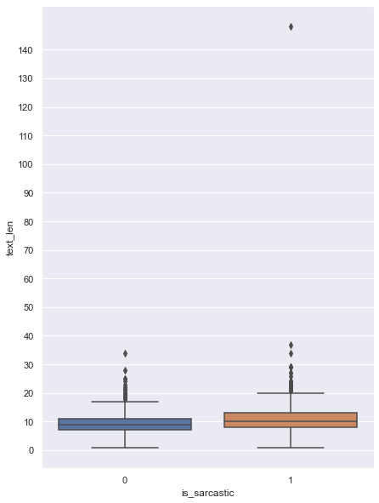
Length of Sentences

Slide 11
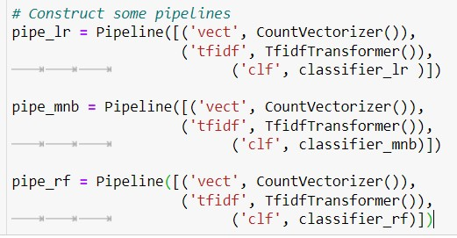
Why Pipeline?
A machine learning pipeline is a way to codify and automate the workflow it takes to produce a machine learning model. Machine learning pipelines consist of multiple sequential steps that do everything from data extraction and preprocessing to model training and deployment.

Slide 12
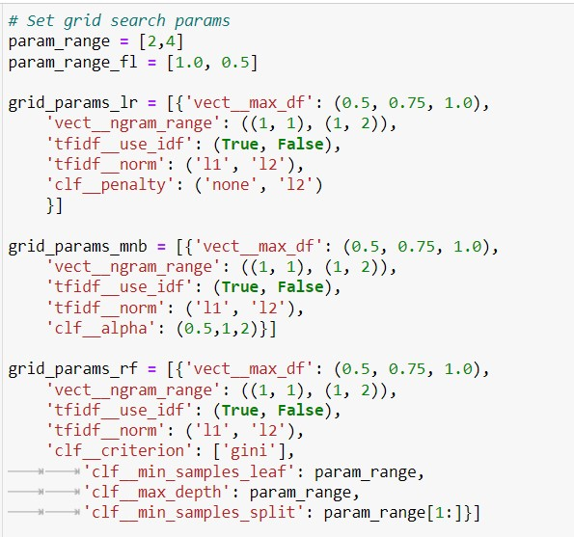
Why RandomizedSearchCV?
RCV only uses a random search over a specified parameter value, they are faster than GSCV. ​
RCV can outperform a GSCV, especially if only a small number of hyperparameters affect the performance of the machine learning algorithm. ​
RCV is also used over GSCV when we have a lot of hyperparameters and using all combinations would be computationally very expensive. For example, Boosted Trees and Neural Networks.

Slide 13
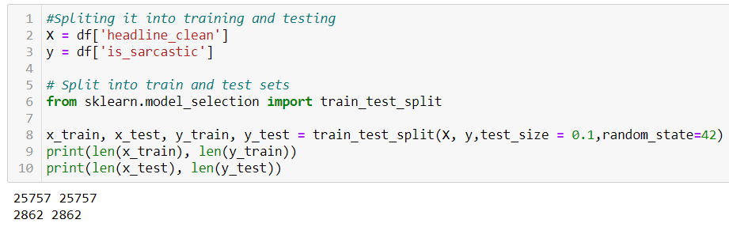
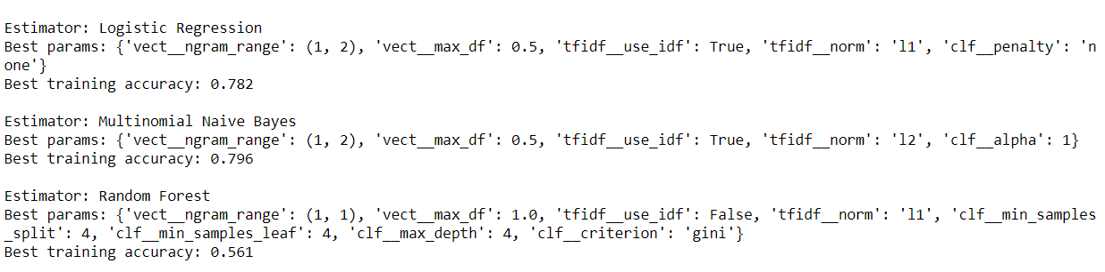
Splitting Dataset and Generating Training Score for Different Machine Learning Models

Slide 14
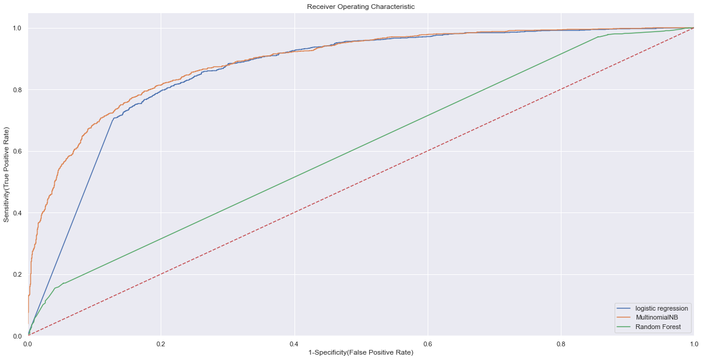
ROC – AUC CURVE
As you can see, Multinomial Naïve Bayes model has the highest ROC-AUC score.

Slide 15
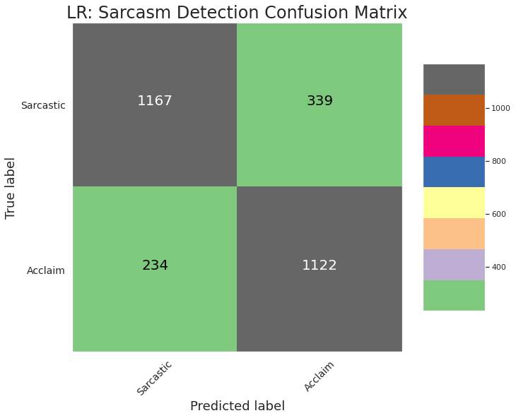
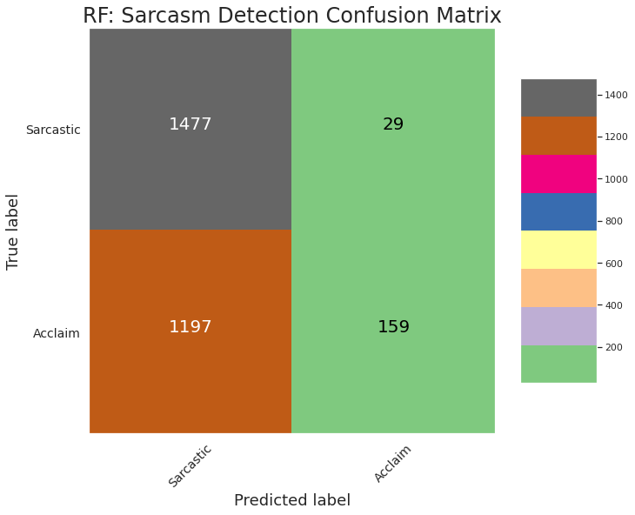
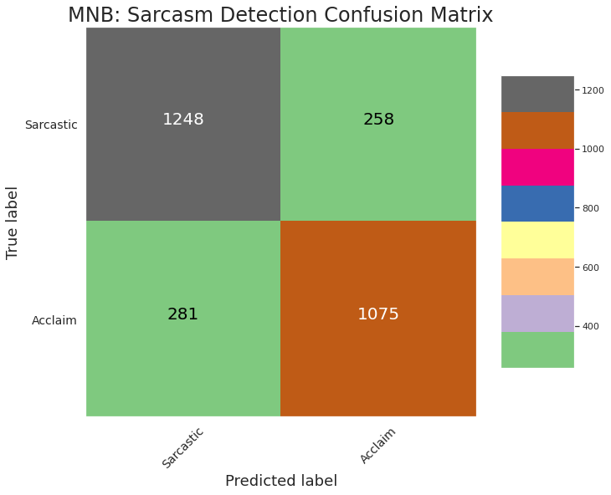
Confusion Matrices

Slide 16
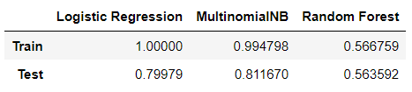
Comparing Results for Different ML Models

Slide 17
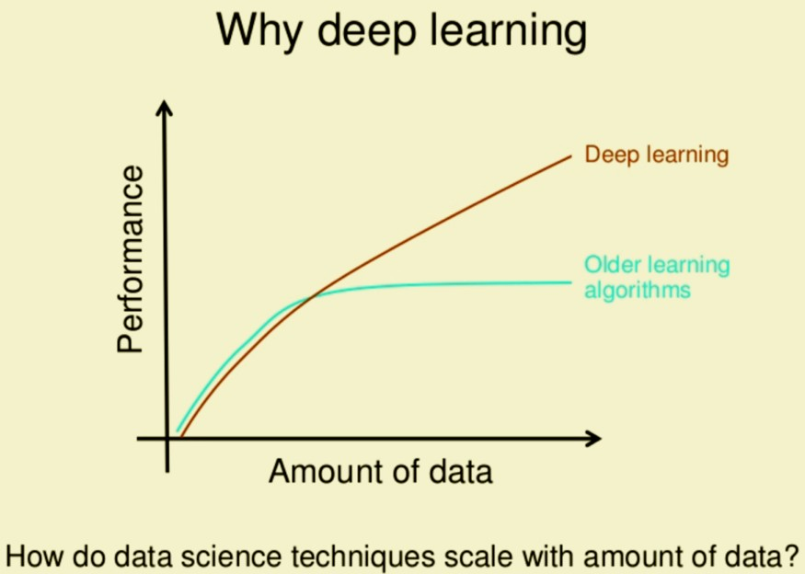
Why Deep Learning over Traditional ML models?
Fun Fact: You will be surprised to know that humans generate more than 2.5 quintillion bytes of data every day, broken to 1.7 megabytes in just a second.
With the rise of computational power and the exponential rise of data, the ability to process large numbers of features makes deep learning very powerful when dealing with unstructured data.
Deep learning algorithms try to learn high-level features from data.

Slide 18
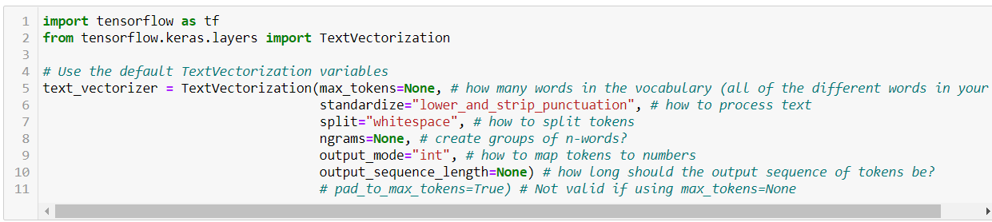
Deep Learning Models
We built our Deep Learning Models in separate notebook and environment to avoid any dependencies.
After Pre-processing the dataset, we split the dataset in Training and Validation sets.
To tokenize our words, we used the helpful preprocessing layer tf.keras.layers.experimental.preprocessing.TextVectorization

Slide 19
GPUs used for the project
GPUs are optimized for training artificial intelligence and deep learning models as they can process multiple computations simultaneously. GPUs are specially design to run matrix calculations much faster than CPU’s.
Google Colaboratory : NVIDIA® Tesla® K80 ( Common for all the notebooks)
Local Systems:
Nvidia GeForce GTX 1660 Ti ( X 2 Systems)
Nvidia GeForce GTX 1650 Ti

Slide 20

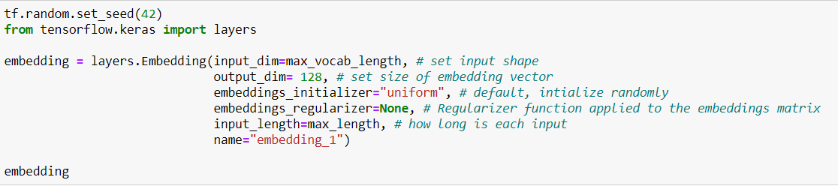
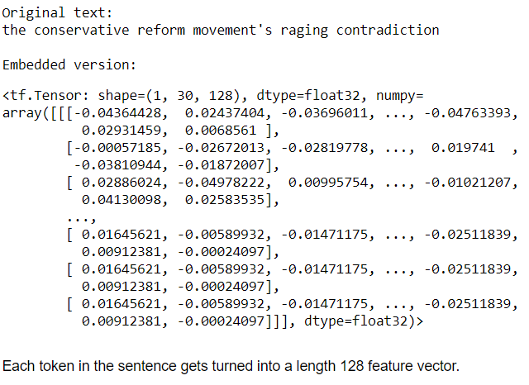
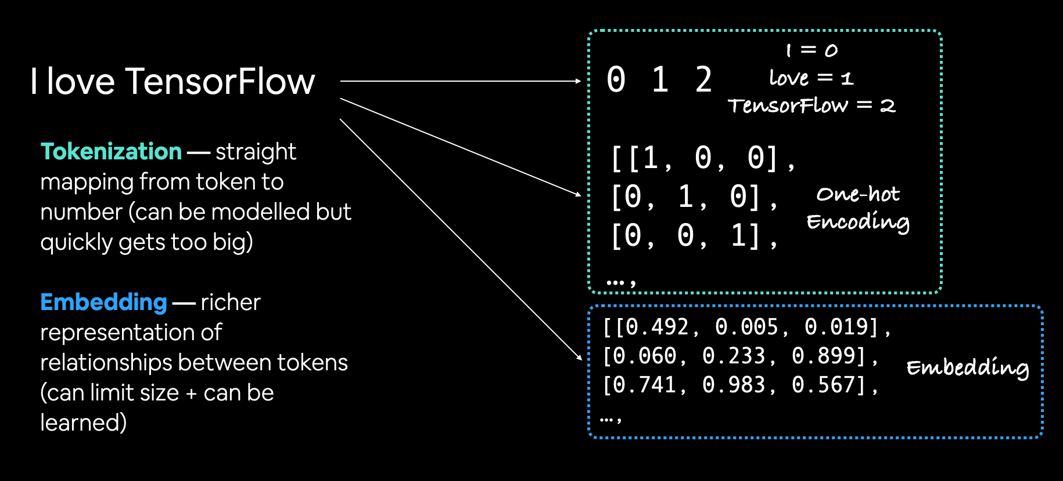
Creating an Embedding using an Embedding Layer
The powerful thing about an embedding is it can be learned during training. This means rather than just being static (e.g., 1 = I, 2 = love, 3 = TensorFlow), a word's numeric representation can be improved as a model goes through data samples. We can see what an embedding of a word looks like by using the tf.keras.layers.Embedding layer.

Slide 21
Baseline Model: Bidirectonal RNN model
LSTM stands for Long Short-Term Memory, is a Gated Recurrent Neural Network, and Bidirectional LSTM is just an extension to that model. The key feature is that those networks can store information that can be used for future cell processing. We can think of LSTM as an RNN with some memory pool that has two key vectors:
(1) Short-term state: keeps the output at the current time step.
(2) Long-term state: stores, reads, and rejects items meant for the long-term while passing through the network.
In Bidirectional LSTM, instead of training a single model, we introduce two. The first model learns the sequence of the input provided, and the second model learns the reverse of that sequence. Since we do have two models trained, we need to build a mechanism to combine both.
Why did we decide to use Bi-LSTM instead of LSTM?
Bidirectional LSTMs are an extension of traditional LSTMs that can improve model performance on sequence classification problems.
In problems where all timesteps of the input sequence are available, Bidirectional LSTMs train two instead of one LSTMs on the input sequence.

Slide 22
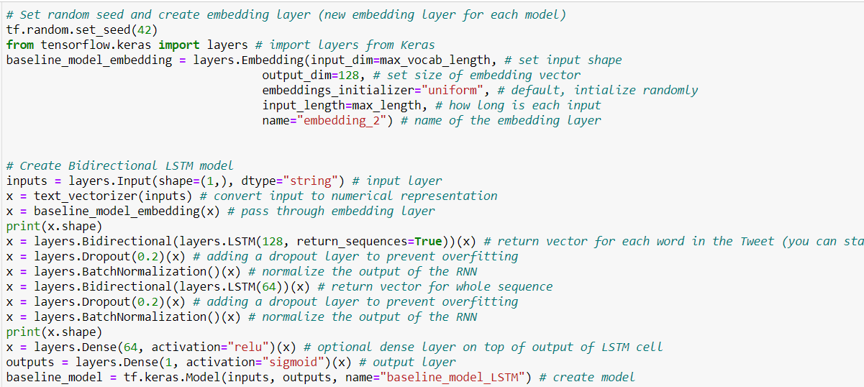
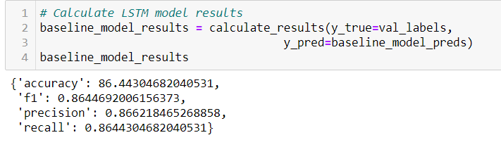

Slide 23
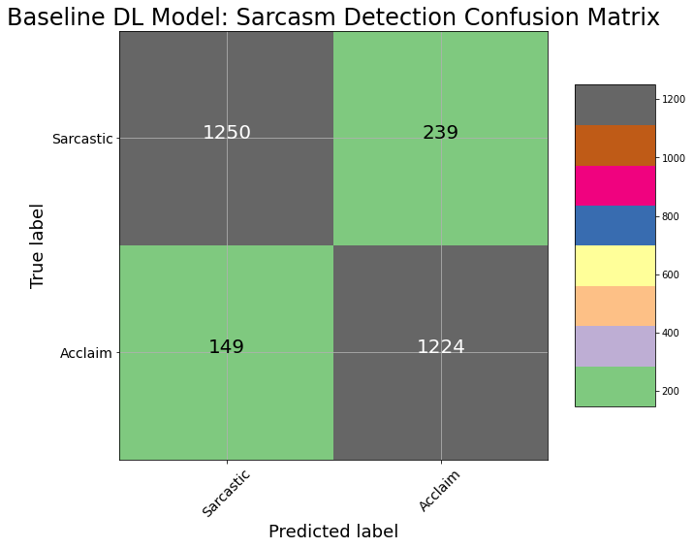
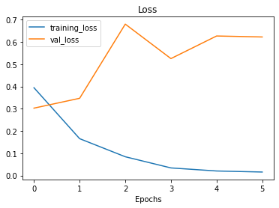

Slide 24
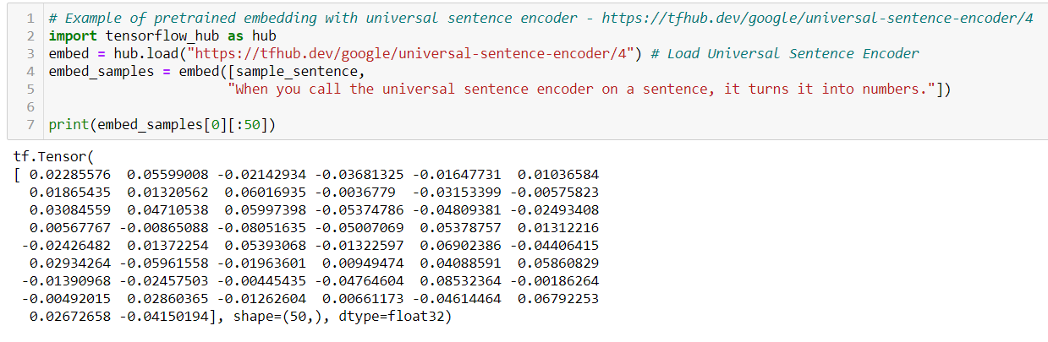
Modeling using Universal Sentence Encoder
The main difference between the embedding layer we created, and the Universal Sentence Encoder is that rather than create a word-level embedding, the Universal Sentence Encoder, as you might've guessed, creates a whole sentence-level embedding.

Slide 25
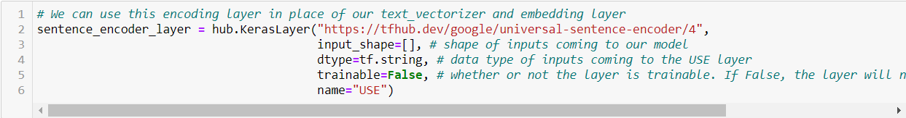
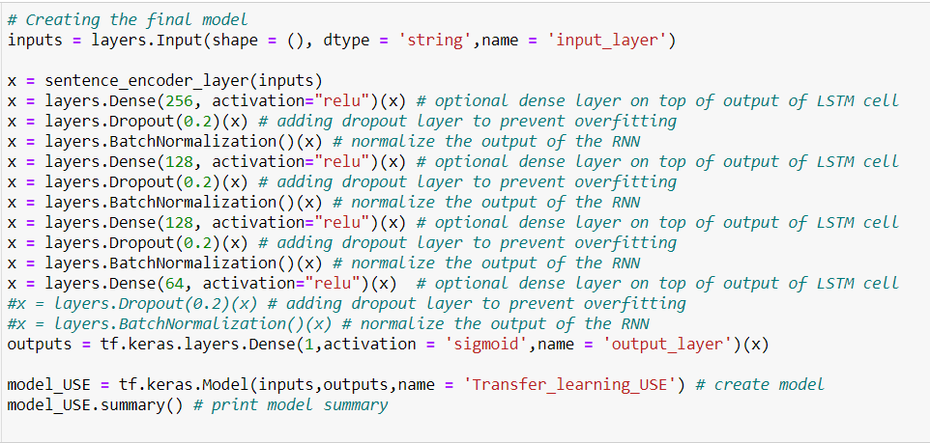

Slide 26
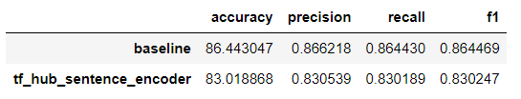
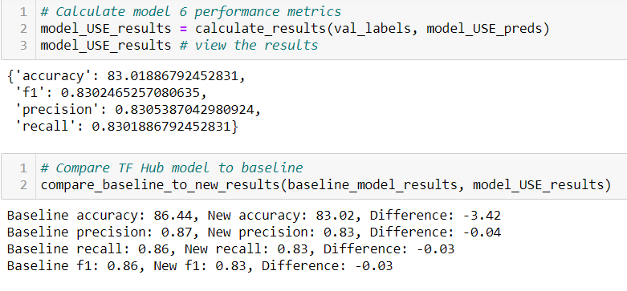
Evaluating our Models performance and comparing it with the Bi-LSTM baseline model

Slide 27
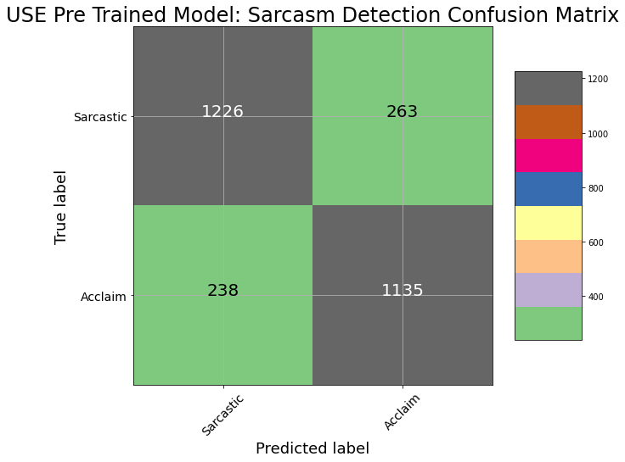
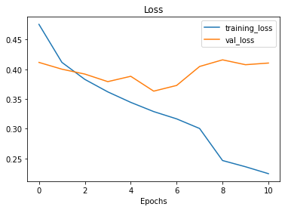
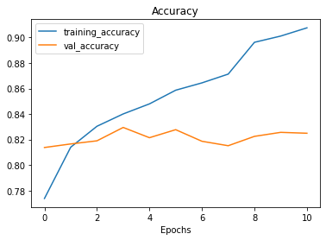

Slide 28
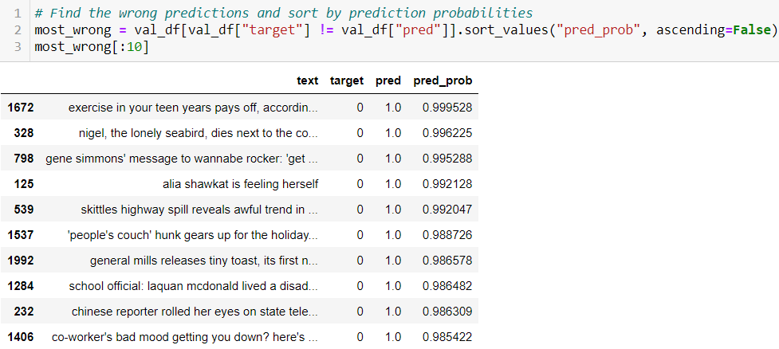
Our Experiments
Finding the most wrong examples
We mentioned before that if many of our modelling experiments are returning similar results, despite using different kinds of models, it's a good idea to return to the data and inspect why this might be.
One of the best ways to inspect your data is to sort your model's predictions and find the samples it got most wrong, meaning, what predictions had a high prediction probability but turned out to be wrong.

Slide 29
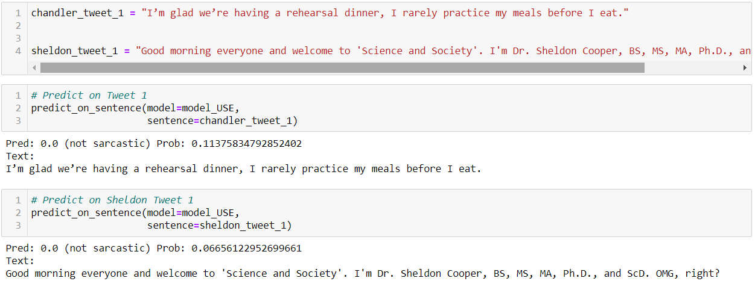

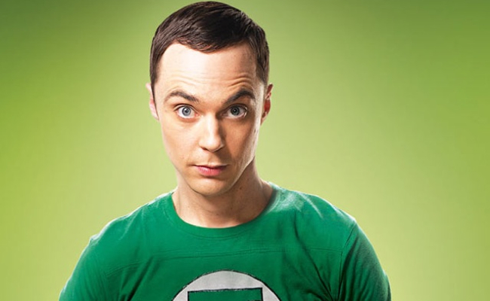
Making predictions on the new data

Slide 30

Thank You

